Slide 1



Logo
Note Vault
AN ASSET MANAGER
-Team Big

Slide 2


PROBLEM STATMENT
We all need different study materials, PYQ’s and academic stuff but usually find it difficult to search over where it could be found. Come up with an innovative solution where we could have a platform accessible to anyone anytime where he could get any material in need and if he has some material, he could donate it to the admin who can update the materials on that platform.

Slide 3
INTRODUCTION
Stressed Over Semester Exam
Hurdles in extracurricular activity participation
Absence due to Medical Reason
Certain topics seem Difficult
Clueless about Teacher Preferences and Metrics of Judgement

Slide 4

PROBLEMS
1
2
3
LACK OF USER INTERFACE
COHESIVITY
ISSUE
INADEQUATE
FEATURES
Taking base of the well known resources at our disposal we have observed the lack of user interface in them resulting in poor user experience and finally into obsolete use.
Bombardment with numerous links makes the student puzzled and confounded in times of examination leading to alot of stess.
The arrangements present at the students disposal right now are just obsolete storeroom of pdf with no personalization to help student out with how to prepare for the specific subject/semester.

Slide 5

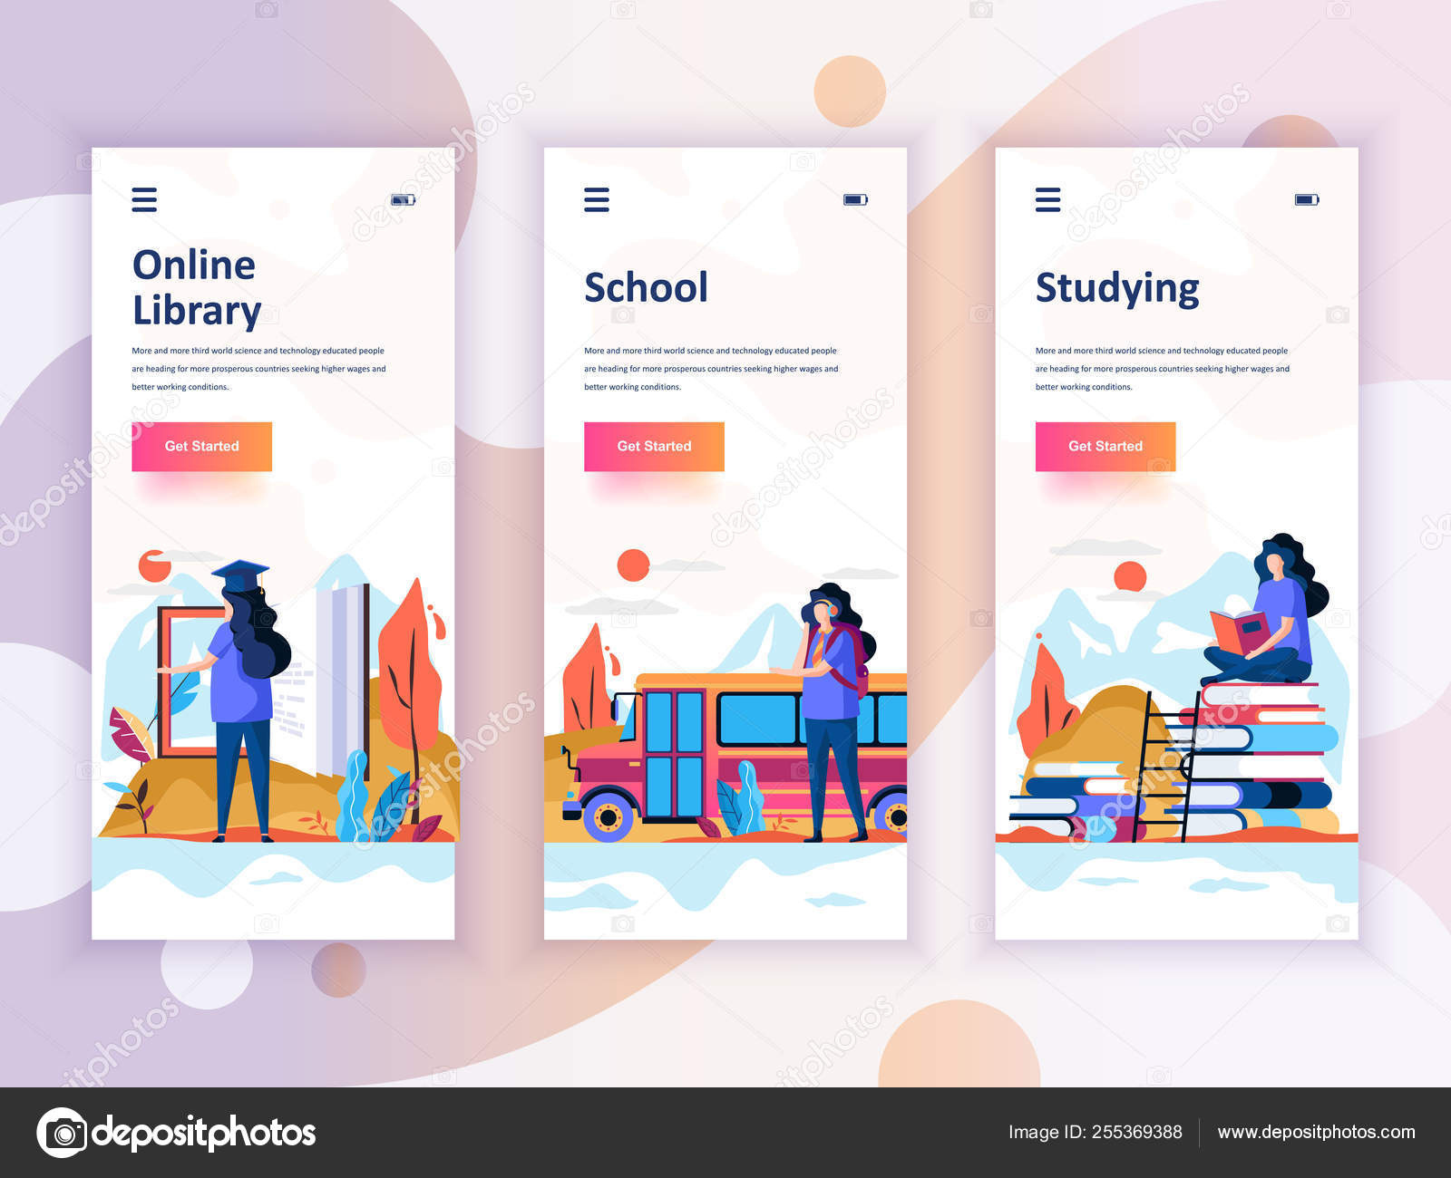
SOLUTION
Seamless Interface
1
Enhanced Interface with smooth access.
Easy and seamless experience through Website.
Centralised Resources
2
It is a one stop solution for all the resources.
Organised availabiliy of resources semester and branch wise with regular updation.
Personalized Experience
3
Features such as Contribution by users , topper notes, Teacher preferences, and a dedicated playlist feature for understanding subjects.

Slide 6



Topper Notes
Toppers notes are the most handy thing to crack any exam ,we plan to include toppers notes for each semester ,so the students have a guide towards cent percent.Along with the reference for lab manuals too.
Teacher Preference
We look towards including data representing the preferences of teacher on which book they refer ,what topics they target in exams ,and the difficulty of their set paper + their attendace criterions.
USP
Open Source Contribution + Acknowlegment
We provide a contibution features to user where they can provide their own notes ,information on teacher preference and thier take on which youtube playlist to follow for a particular subject along with a shoutout to weekly and top contributors.
Playlist + Embedded PDF Reader
Dedicated YT playlist to ace each subject in MSE and ESE along with crystal clear view of the subject + embedded pdf viewer for hassle free experience for the user

Slide 7






TECHSTACKS
REACT JS
TAILWIND
FIREBASE
NODE JS
FIGMA

Slide 8
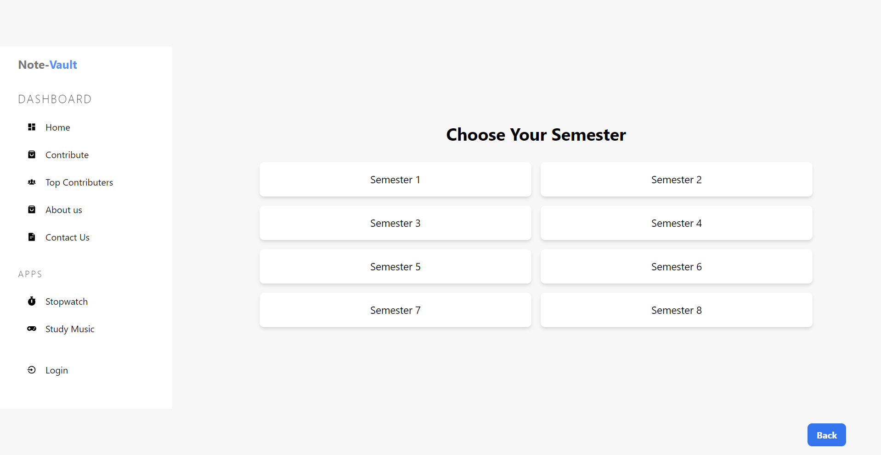
Implementation
Dashboard
The frontend dashboard serves as the central hub for all project functionalities.
It offers a user-friendly interface to access various features.

Slide 9
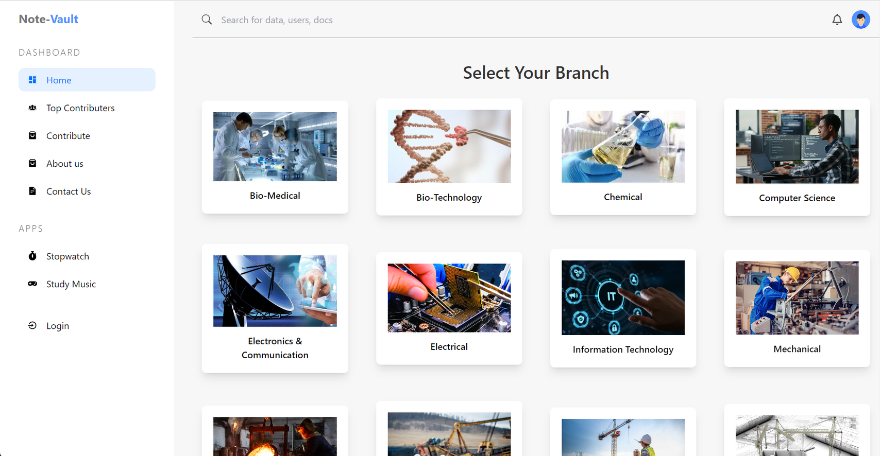
Note Vault - Branch Selection
Users can select their academic branch of study.
This choice customizes their experience by aligning content with their curriculum.

Slide 10
Note Vault - Semester Selection
After selecting a branch, users can choose the semester they are currently studying.
This allows users to access resources specific to their academic year.

Slide 11
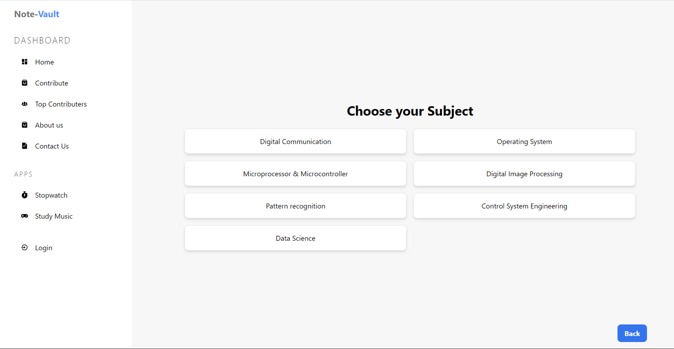
Note Vault - Subject Selection
After selecting a branch, users can choose the semester they are currently studying.
This allows users to access resources specific to their academic year.

Slide 12
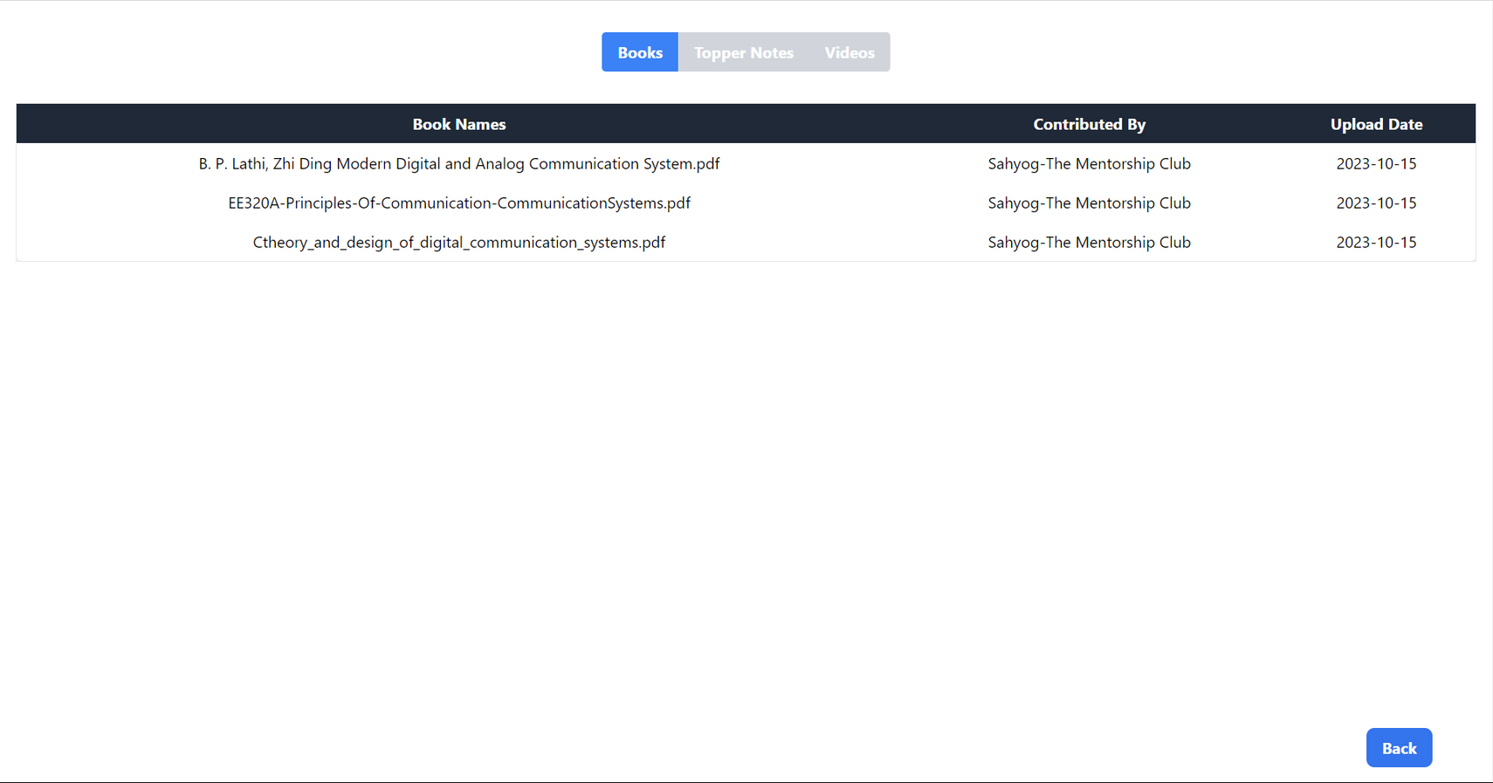
Note Vault - Book Selection
The book selection section displays the recommended books for the chosen subject.
Users can read these books online, making it a valuable resource for study.

Slide 13
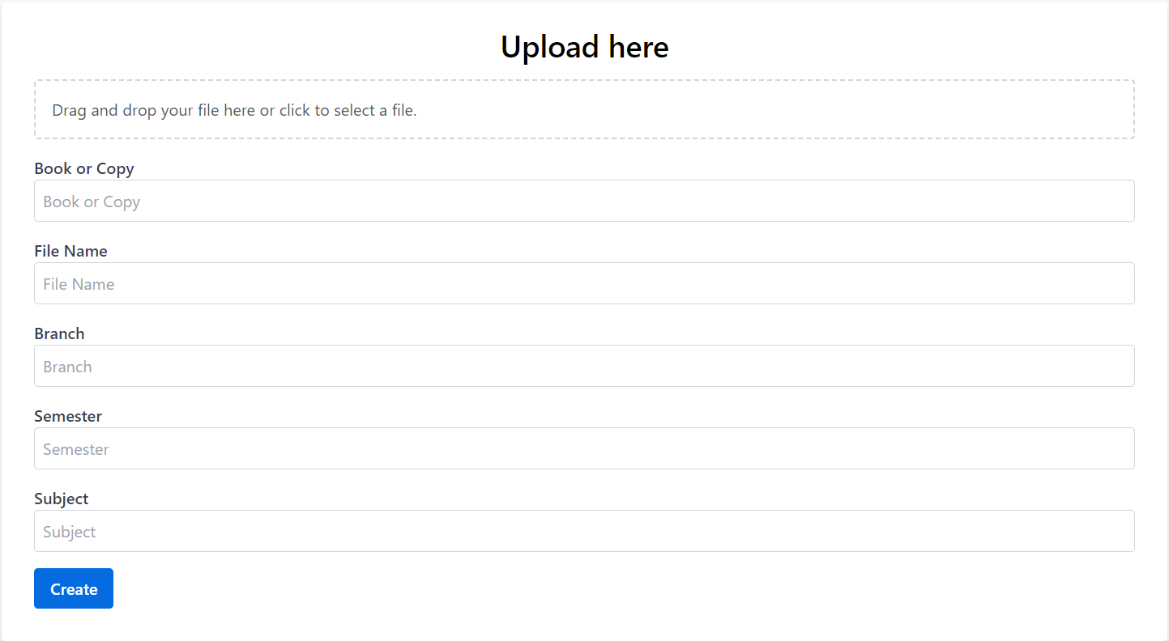
Contribute Section
This section empowers users to contribute their own notes or relevant books to assist fellow students.
It encourages collaboration and knowledge sharing within the community.

Slide 14
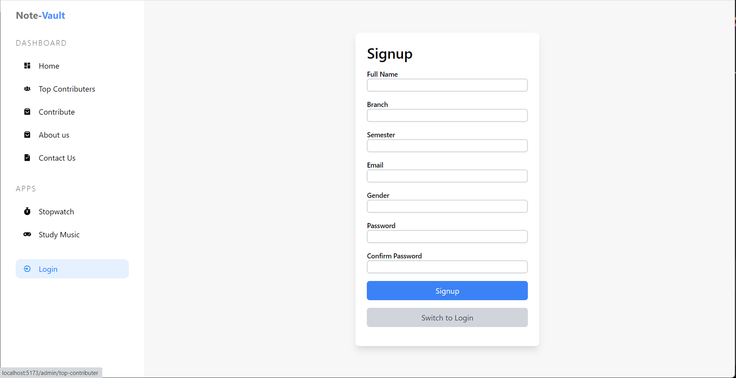
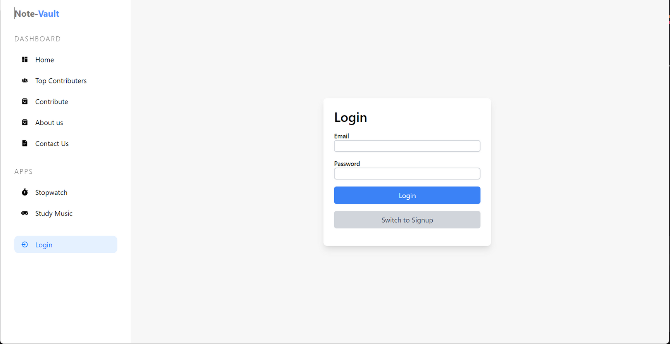
Login/SignUp Section
Login
For returning users who already have accounts. Users provide their registered email and password to access their personalized dashboards.
Sign Up
For new users to create accounts. It collects user information, including name and email, and allows users to set up secure login credentials.
Optional features may include password reset and terms acceptance. Successful registration redirects users to the login page for access.

Slide 15
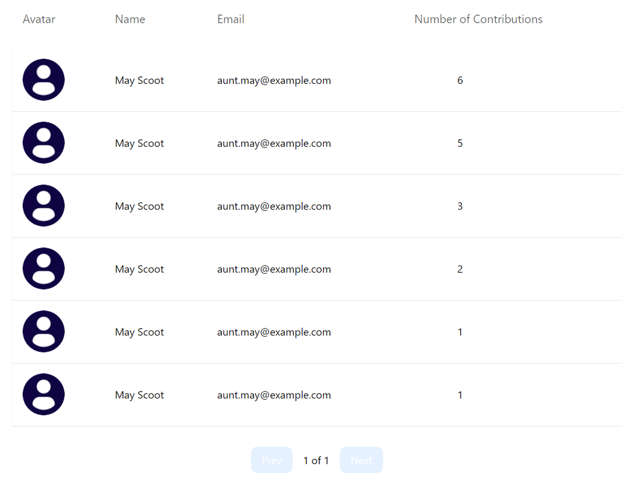
Top Contributers
Acknowledge and celebrate the efforts of top contributors.
Display the names or profiles of users who have made significant contributions.

Slide 16
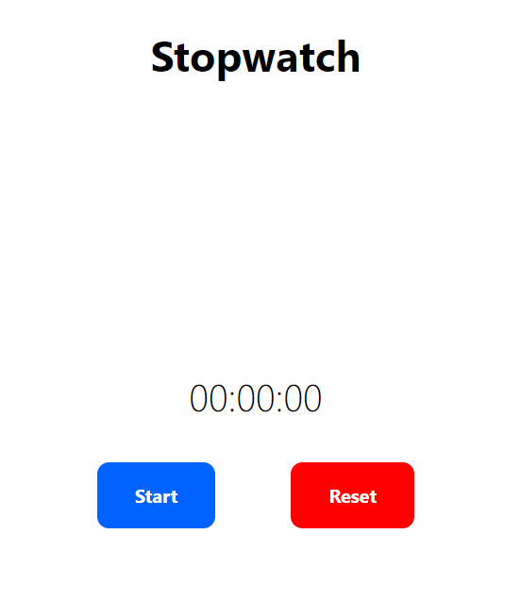

Extra Features
Study Timer
This section empowers users to contribute their own notes or relevant books to assist fellow students.
It encourages collaboration and knowledge sharing within the community.
Study Music
The study music feature enhances the learning environment with soothing background music.
Users can choose from a selection of study playlists or tracks.

Slide 17


Target Audience
Diverse audience: College students seeking streamlined access to educational resources.
Efficient, user-friendly platform for subject-specific materials.
Tech-savvy or those seeking a hassle-free learning experience.
Seamless, engaging resource hub tailored to preferences.

Slide 18

Future Roadmap
App Intergration
AI
Enhancement
Scalability
FOSTER CROSS-PLATFORM CONVENIENCE AND ACCESSIBILITY FOR STUDENTS ON THE GO.
DEVELOP INTELLIGENT CHATBOTS TO PROVIDE INSTANT ASSISTANCE AND SUPPORT.
PREPARE FOR GROWTH TO SUPPORT MORE COLLEGES.

Slide 19

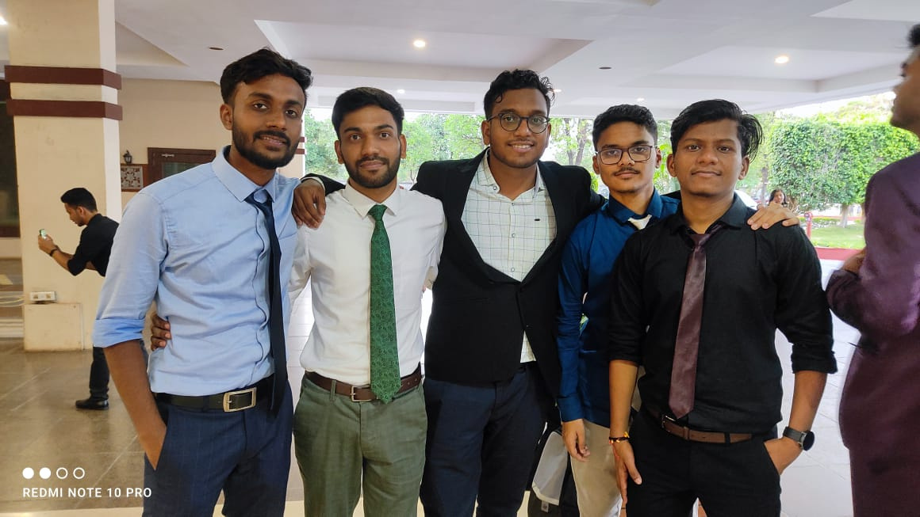
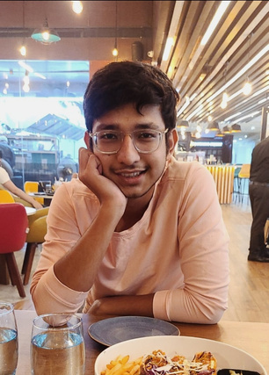
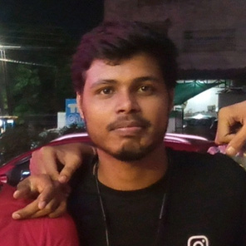
The Team
Pranjal Naman ,ECE
Shayan
Khan, ECE
Prince Tripathi, ECE
LEADER + FRONT END
DESIGNER + FRONT END
BACKEND

Slide 20
Thank You

